Slide 1
Java EE Training Course
Git Introduction
Notes:
ATS Application Programming: Java Programming
Brown Bag: XML
© Accenture 2005 All Rights Reserved
Course Code #Z16325

Slide 2
Agenda
VCS
Commits and branches
3. Main git commands
Notes:
ATS Application Programming: Java Programming
Brown Bag: XML
© Accenture 2005 All Rights Reserved
Course Code #Z16325

Slide 3



Version Control System (VCS)
Version control, also known as revision control or source control,^{[1]} -management of changes to documents, computer programs, large web sites, and other collections of information.
Changes are usually identified by a number or letter code, termed the "revision number“.
List of most popular VCSs:
Subversion (SVN)
Mercurial
Git
Notes:
ATS Application Programming: Java Programming
Brown Bag: XML
© Accenture 2005 All Rights Reserved
Course Code #Z16325

Slide 4
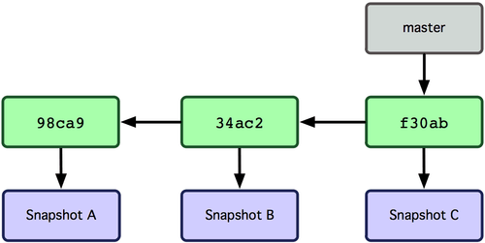
Commits and branches
Commit To commit (check in, ci or, more rarely, install, submit or record) is to write or merge the changes made in the working copy back to the repository. The terms 'commit' and 'checkin' can also be used as nouns to describe the new revision that is created as a result of committing.
Branch A set of files under version control may be branched or forked at a point in time so that, from that time forward, two copies of those files may develop at different speeds or in different ways independently of each other.
Notes:
ATS Application Programming: Java Programming
Brown Bag: XML
© Accenture 2005 All Rights Reserved
Course Code #Z16325

Slide 5
Activity
Install git (https://git-scm.com/downloads)
2. Set your name and email
git config --global user.name "John Doe"
git config --global user.email johndoe@example.com
3. Init repo for your FlowerShop project
git init
4. Create git.ignore file to ignore /target folder and eclipse project files for git
5. Make initial commit
git add .
git commit –m “Initial commit”
6. Commit changes to repo after stable features implemented (like in 5 but with feature description in commit)
https://git-scm.com/book/ru/v1/%D0%92%D0%B2%D0%B5%D0%B4%D0%B5%D0%BD%D0%B8%D0%B5-%D0%9E%D1%81%D0%BD%D0%BE%D0%B2%D1%8B-Git
Notes:
ATS Application Programming: Java Programming
Brown Bag: XML
© Accenture 2005 All Rights Reserved
Course Code #Z16325

Slide 6
Questions
???
Notes:
ATS Application Programming: Java Programming
Brown Bag: XML
© Accenture 2005 All Rights Reserved
Course Code #Z16325

